Slide 1
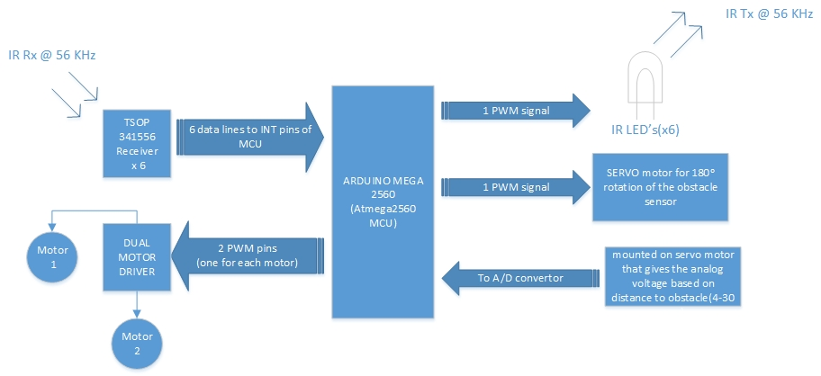
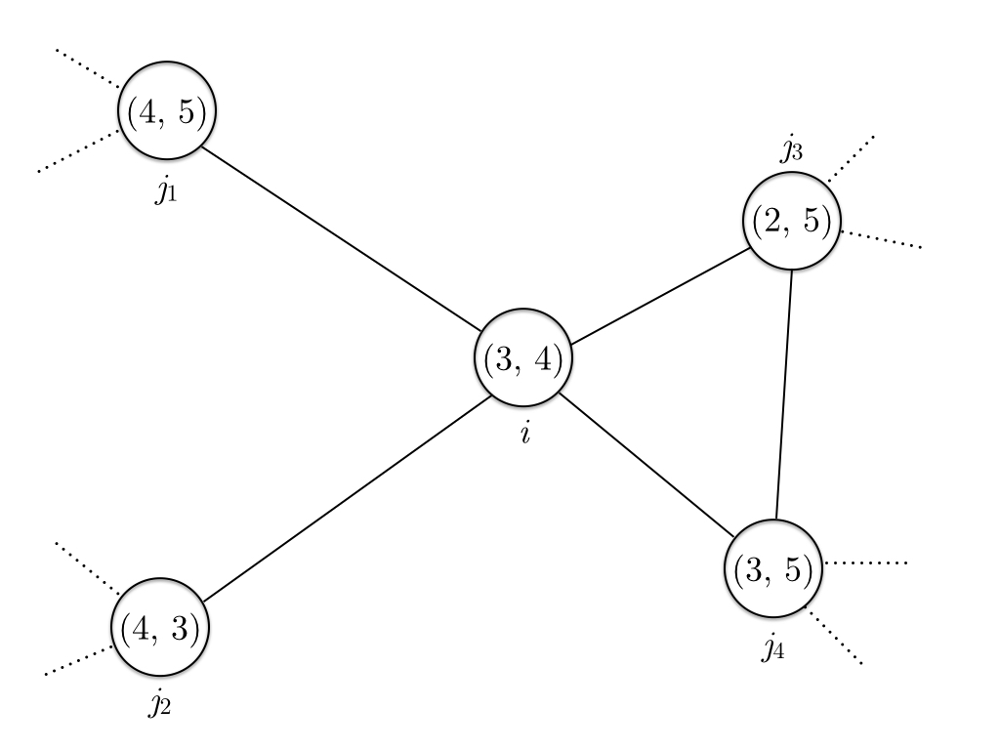
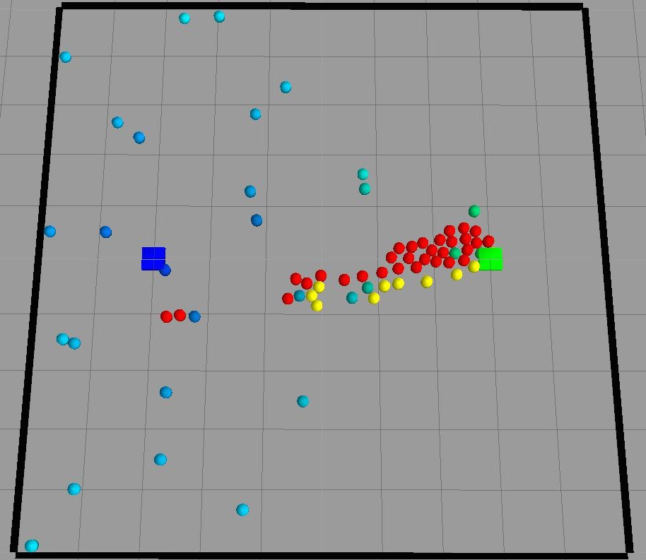
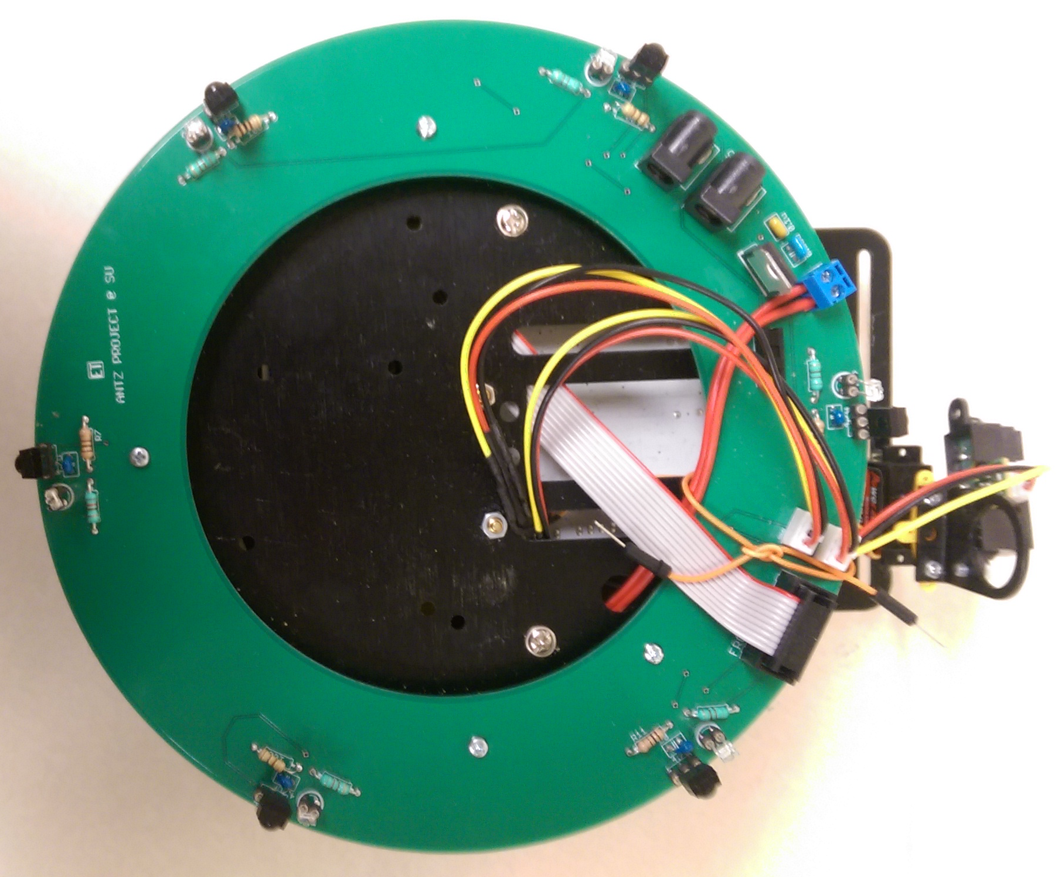
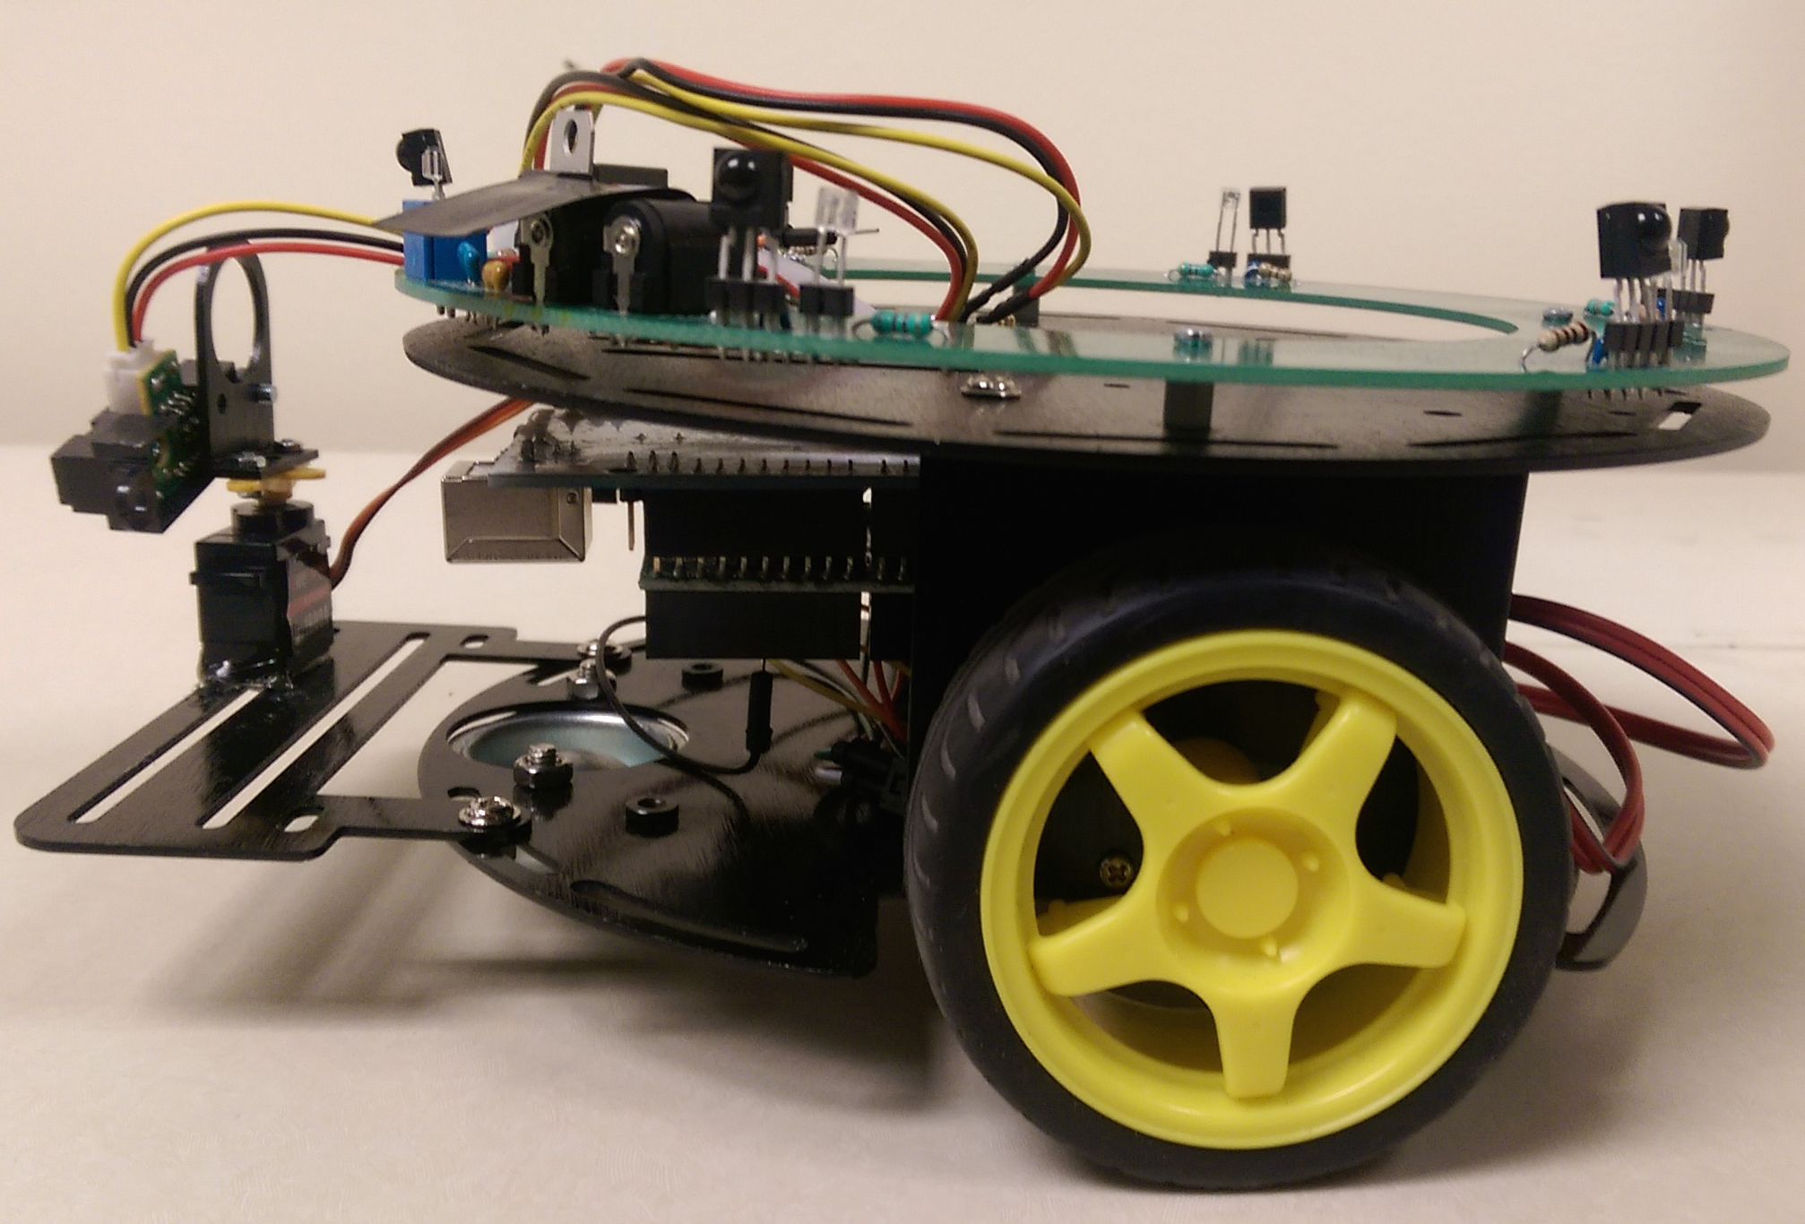

Swarm Robotics
Zhi Xing, Gajendranath Gaurav Roy Puli
Syracuse University
Abstract
Foraging Algorithm
Hardware
We’re working on robot swarm foraging, where a swarm of robots find and transport “food” using local communication and coordination without any kind of centralized control. The algorithm we’re using dynamically assigns one of two roles to a robot: an explorer or a guider. The guiders, called beacons, broadcasts signals and the explorers, or walkers, explore and world and follow the signals. We have successfully simulated the algorithm in Gazebo robotics simulator, designed and manufactured a robot prototype, named Antz, for swarm robotics applications such as foraging, and developed software packages for Antz.
The goal of foraging is for the robots to find the food source(s) in the world and bring foods back to the nest. In the algorithm we’re implementing, each robots can take up one of two roles: walker or beacon.
A beacon is stationary. It stores a nest cardinality and a food cardinality, and broadcasts these two values. It also receives broadcastings from neighboring beacons, and sets its own cardinalities to the received minimum cardinality value plus one. The beacon next to the nest has nest cardinality 0 and the beacon next to the food source has food cardinality 0. Effectively, beacons and targets (nest and food source) form a network, and the cardinalities of a beacon are gradient values indicating the distance of the beacon to the targets.
An example of such a beacon network is shown in Figure 1. In this network,
nodes are beacons and an edge between two beacons indicates they’re within communication radius of each other. The values in a node are (nest cardinality, food cardinality) of the beacon. The cardinalities of beacon i are (3,4) because the minimum nest cardinality it receives is 2, which is from beacon j₃, and the minimum food cardinality it receives is 3, which is from beacon j₂.
A walker is mobile. It doesn’t send out any data, but receives the broadcastings from beacons and follows the minimum values to reach a target. For example, if a walker is going towards the food, it will compare all the food cardinalities it receives from the beacons in its vicinity and go towards the one sending the minimum value.
The hardware for the robot is kept as simple as possible so as to make it robust and for the most cost effective solution.
It consists of the following parts:
Arduino Mega (Running the AtMega2560 uC)
Pololu Motor driver()
Two individually controlled wheels and a freewheel in the front.
A PCB in the shape of an annular ring that houses all the emitters and receiver and all other circuitry.
A 7-segemnt display and four LED's that displays the value of the signal it is receiving or the value it is sending which makes it easier to debug during experiments.
The receivers(TSOP34156) are the ones normally found in TV receiver's and operate at 56 KHz frequency. The inbuilt circuit used in the receiver eliminates all other IR frequencies and accepts only 56KHz and converts the signal into a digital signal of 0 and 1, the component being passive high and active low.
For transmission of the IR signals, high power IR LEDs are used whose angle of incidence is 50 degrees and forward current of 100mA.
IR obstacle sensor in the front of the robot is placed on a servo which enables it to rotate 180 degrees and scan the environment around the robot for any oncoming obstacles. This sensor can detect an obstacle anywhere in between 4-30 cm.
Given below is a high level datasheet representing all the components and how they are connected in the robot.
Introduction
In swarm robotics, a large number--perhaps thousands--of robots must cooperate to achieve common goals. The key challenges are scalability and robustness in the absence of centralized controls.
Many swarm robotics researchers use the foraging problem as a test bed for new algorithms. Foraging problems can represent a variety of problems including search and rescue. In this problem, robots must find locations of “food” without any previous knowledge or a centralized control.
Our approach uses completely distributed and autonomous robots that can dynamically assume useful roles, either being explorers or guiders, by utilizing their local information only. Because our solution is completely distributed and localized, it is expected to scale out very well even with an extremely large number of robots.
We also developed a robot hardware prototype that can be used for general swarm robot research. The hardware utilizes the Arduino Mega 2560 board and infrared emitters and receivers for communication and obstacle detection. The key difficulty of designing the robot is the communication protocol, which currently is implemented as a state machine running as Interrupt Service Routines.
Simulation
We implemented the algorithm in Gazebo, a open-source robotic simulator with Open Dynamic Engine (ODE). We chose Gazebo because it can better reflect problems such as collision and congestion. Figure 2 is a picture the simulation after the food source has been located. The blue square is the nest, the green square is the food source, red circles are walkers going towards food, yellow circles are walkers going towards nest, and blue/green circles are beacons. The blueness and greenness indicate a beacon’s distance to nest and food source.
Figure 4. High-level overview of hardware
Figure 1. A beacon network
Figure 2. Gazebo simulation
Figure 3. Top and side view of Antz robot
Contacts
Zhi Xing
zxing01@syr.edu
Gajendranath Gaurav Roy Puli
gpuli@syr.edu

